Slide 1





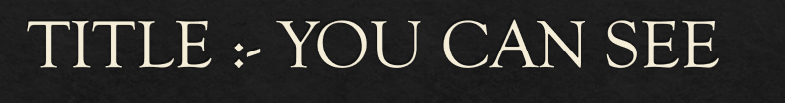
TEAM MEMBERS:-
Naveen S
Karishma R
Hemalatha M
Lakshmi Praba S
Kesavan T

Slide 2
INTRODUCTION
We are glad to submit our idea regarding the people who are visually impaired .
Our main aim is, the visually impaired people can also do as same as the normal people.
In this, we planned to create a software application to do a certain things for the visually impaired people.
Here we are introducing a device like eyeglass that will help to guide blind people in certain activities.

Slide 3
PROBLEM STATEMENT
EMPOWERING THE DIFFERENTIALLY ABLED WITH TECHNOLOGY:
To create apps or IoT projects that can empower people with disabilities.
1.Dificulties of reading
2.Pathway detection

Slide 4
PR0BLEM SOLUTION
By using our device, it scans the text of the page using a AI camera and it enables the user to hear the text.
To find the obstacles in the path of the user.

Slide 5
Construction of the Application
First and main theme of the app is to find the person who was already registered in the application.
By recording the physical action and voice of visually impaired people, the recorded signal is transformed to the application thus, it helps to find the right person.
In this software application, we are adding new things like Google assistant, Alexa etc., These things helps visually impaired to make communication and also useful for searching things.
If any defect appears in the smart glass ,it will quickly alert the person.

Slide 6
Working of the Smart Glass
Technology like smart glass doesn’t change a person’s vision, it helps process visual information.
Our main theme by the use of this smart glass is, the blind person also feels like a normal person without any insecurities and fear.
For visually impaired people, when the new people is introduced to them they feel some insecure or confused about the people. But using this smart glass, for the first time the smart glass scans the people only for 10 seconds it records and stores the information about the people.
And the next time, when they meet each other , mobile application reminds the blind people who they are, with the help AI camera in the smart glass.

Slide 7
Working of the Smart Glass
The smart glass also helps in pathway detection with the help of AI camera and sensors like luminar sensor and intelligent image sensor.
For Example, When non-living thing is near to you i.e, 10 feat near it will sound on different alarm and when the living thing is near to you i.e, as same as 10 feet near, it will sound with different and unique stations of sound.
It also recognizes the product colours and vehicle type etc….

Slide 8
Working of the Smart Glass
Gesture like checking the times with or without a watch.
The visually impaired people can also read books like us.
For example, they can scan the book with the help of AI camera (by voice commands like, “ok smart glass scan the book” ) and AI like alexa or google assistance will translate it.

Slide 9
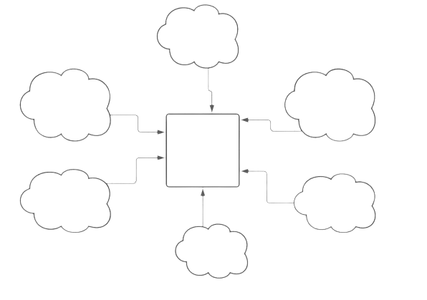
Block Diagram of Smart Glass
Mic
AI Camera
Ultrasonic
Raspberry
pi
Battery(5V,2A)
sensors
Vibrator

Slide 10
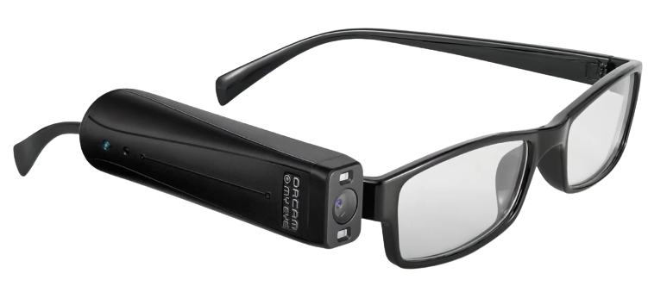
Model of the Smart Glass

Slide 11
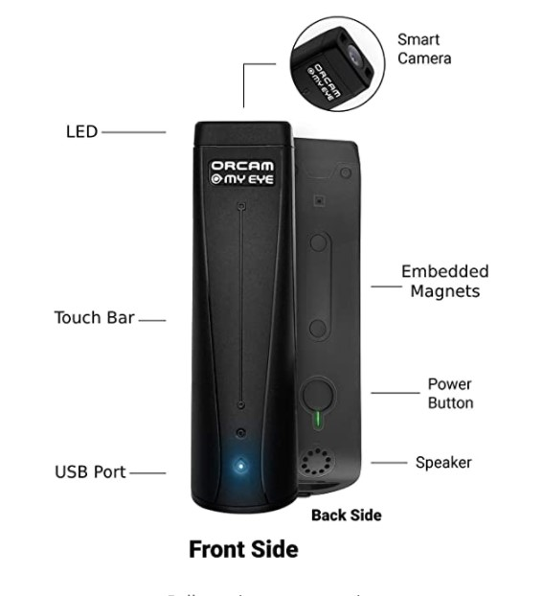

Slide 12
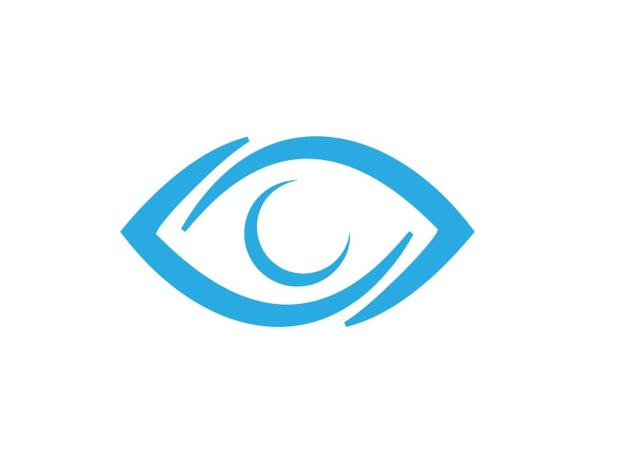
REFERENCE
Our Mobile App : EYE BOOK
Further Reference : https://youcansee.nicepage.io

Slide 13


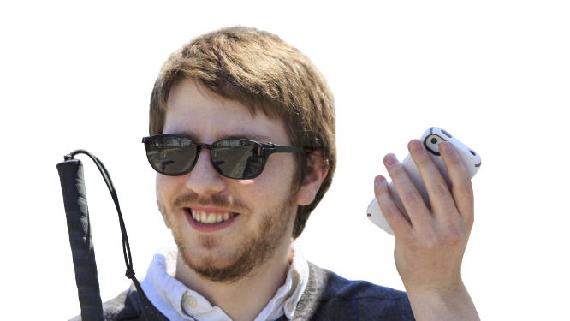

CONCLUSION
Here we are summarising our project regarding the soft copy of smart glass device. I think it should succeed in future at the top most level in India, but the cost of this device is very high and expensive. So it is one of the main drawbacks of this project. Hence we are enclosing our ideas with fulfilled and pleasant thoughts.

